Slide 1
CSE514 – Datamining Fall 2022 Clustering
Cynthia Ma
Department of Computer Science
Washington University in St. Louis
czma@wustl.edu
Notes:
병찬, 11/2
오늘은 처음부터 카훗이네.. -_-
Difference between Supervised and Unsupervised learning? => The use of testing data(x) The use of data labels(o)
Detection of spam emails is an application of? => Supervised:Classification(o)
Signature recognition is an application of? => Supervised:Classification(o)
PCA is an application of ? => Supervised:Regression(x), Unsupervised:Dimension reduction(o)
Rainfall forecasting is an application of? => Supervised:Regression(o)
Credit card fraud detection is an application of ?=> Supervised:Classification(o)
병찬, 11/7
오늘도 처음부터 카훗이네 -_- 시간이 남나봐..
I which of the following scenarios would EM with GMM be better than k-Means? => EM에 적합한건 2번이다
1번은 각각의 원이 떨어져서 뭉쳐져 있음. k mean 도 잘 할 모양.. 뭉쳐져 있음
정답 - 길쭉한 타원형이 아슬하게 떨어져 있는 모양인데 이게 가우시안 벨류를 조정하면서 딱 들어맞을 수 있음
3번은 곡선이 섞여 있어서 k mean 이랑 EM 둘다 못함
4번은 원 안에 원이 있는 모양인데 k mean 못하고 em 도 못함 linear 하게 분리 가능해야 kmean 하고 EM 이 다 잘됨
What did both methods fail to identify? (k mean 과 EM 이 실패하는건?)
정답 – Outliers, color
What are the possible problems of picking a bad bandwidth for Mean Shift clustering?
문제가 뭐냐하면 이미지 3장이 있는데 3가지 무더기가 있음. 잘 분류된거 (각 무더기에 맞게 색칠함) 어느정도 분류가 잘못된거(각 무더기에 여러 개 색깔이 섞여 있음(bandwidth 가 작은 경우), 더욱 분류가 잘못된거(한무더기를 넘어서 색깔이 칠해져 있음,bandwidth 가 너무 큰 경우)
정답 – 1.overlaps 2.too many or too few clusters
For which of the following do you have to pick k before clustering?
Agglomerative
정답 => K-Means
Mean Shift
Divisive
정답 => Em with GMMs
DBScan
Which of the following cluster with a distance metric?
정답 => Agglomerative
정답 => K-Means
Mean Shift
정답 => Divisive
정답 => Em with GMMs
DBScan
=======➔ mean 하고 dbscan 은 밀도를 이용한다.
Which of the following can cluster groups that aren’t linearly separable?
정답 => Agglomerative
K-Means
Mean Shift
정답 => Divisive
Em with GMMs
정답 => DBScan
What’s changing between the t-SNE cluster results?
Number of steps
Learning rate
정답 => Perplexity
What features of the original cluster is not consistently captured by t-SNE?
문제가 점들이 분류되어 있는 것들인데,,, 암튼 밀도랑 사이즈가 변했음 분류후에
정답 => Cluster size and density
What features of the original cluster is not consistently captured by t-SNE?
문제가 점들이 분류되어 있는 것들인데 분류후에 거리가 유지가 안됨.
정답 => Relative distance
What features of the original cluster is not consistently captured by t-SNE?
문제가 점들이 선처럼 모여있는건데
정답 => shape 가 유지가 안됨
Given the winning use case, suggest a clustering method

Slide 2
“Learning” with data
Supervised learning: we have labels
Classification to predict nominal labels
Regression to predict continuous labels
Unsupervised learning: we don’t have labels
Clustering to find substructure and outliers
Association mining to find variable relationships
PCA dimension reduction to reduce data size while maintaining as much “information” as possible

Slide 3
Goals
Supervised learning
We know what interests us about the data: the label
Fit a model so that we can predict the interesting information from data that’s easier to get
Evaluate the model based on accuracy of predictions
Unsupervised learning
We have a large dataset and want to find something interesting about it
Ask a model to determine if something is interesting or not
Evaluate???

Slide 4
Practical Applications
Supervised learning
Document classification – spam detection
Signature recognition – accept checks online
Weather forecasting – how much will it rain tomorrow?
Unsupervised learning
Anomaly detection – credit card fraud
Customer recommendations – online cart suggestions
Summary visualizations – t-SNE “clusters”

Slide 5
Clustering
Two main principals:
Maximize similarity within groups
Minimize similarity between groups
Can discover new sub-structures
Can make labeling easier
Evaluation
Some limited labels are available for validation
Newly discovered sub-structures are deemed “useful”

Slide 6
Hierarchical Clustering
8
10
3
0
4
4
Data is organized into layers of clusters
Top layer: all data points are part of the same cluster
Bottom layer: all data points are their own cluster
Moving up or down through the layers, merge or divide the clusters
4.83
2.75
9
3.67
4
0
3
4
4
8
10
Notes:
병찬, 여기서 카훗으로 문제를 냈는데…
클러스터링 순서를 묻는 문제임
보기 {2.75, 9} {8, 10} {0, 3.67} {3, 4}
나의정답은
{3, 4} ->{0, 3.67} ->{8, 10} -> {2.75, 9}
정답은 (이게 격차가 작은것들끼리 그룹으로 무끄면 됨)
{4,4} -> {3,4} -> {8,10} -> {0, 3.67} -> {2.75, 9}

Slide 7
Vocabulary
8
0 | 4 | 8 | 3 | 4 | 10
10
3
0
4
4
4 | 4 | 3 | 0 | 8 | 10
Agglomerative(뭉쳐있는)
Start at the bottom, all datapoints are their own cluster
Merge clusters together based on similarity
Divisive(분열된)
Start at the top, all datapoints are one cluster
Divide into sub-clusters based on reduction of spread
Dendrogram: the “tree” visualization(계통수)
Any number of clusters can be found by interpreting the dendrogram at different layers
Heatmap: color value visualization, sorted by clustering distances
Notes:
병찬
오른쪽 상단 첫번째 네모 상자들은 그냥 글자를 순서(왼쪽 -> 오른쪽) 으로 읽었을때 순서이고
두번째 네모 상자들은 비슷한것끼리 묶은것임.

Slide 8
Agglomerative algorithm
Define a distance/similarity function
Manhattan, Euclidean, Hamming distance
Define a method of comparison
Centroids: distance between cluster means
Single-linkage: distance between closest members of clusters
Complete-linkage: distance between furthest members of clusters
Define each data point as its own cluster
Loop until all data is a single cluster:
Find the two most similar clusters
Merge into one cluster
Notes:
병찬
어떻게 뭉치는지 알고리즘 설명이다.

Slide 10
Divisive algorithm
Define a metric of spread
Average Euclidean distance from the centroid
Maximum Hamming distance within the cluster
Define a method of division
Define new centroids within the cluster and allocate points to the closest centroid
Define all data points as part of one cluster
Loop until all data are in their own cluster:
Find the cluster with the greatest spread
Divide the cluster

Slide 11
Agglomerative vs. Divisive
Agglomerative
Easy to implement
Merges are motivated by local structure
Getting to “k” clusters is a blind, possibly long, search
Divisive
The heuristic for division can be tricky
Divisions are motivated by global structure
Getting to “k” clusters can be quick, with easy to implement shortcuts

Slide 12


Slide 13
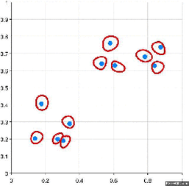

Slide 14
k-Means Clustering
General approach:
Start with a prespecified number of clusters, k
Randomly pick k samples to act as centroids
Recursively assign samples to closest centroid, then recalculate centroid using assigned samples
Results in a division of the data set into k (non-overlapping) subsets
Limited to the number of clusters initialized, and can converge poorly depending on initialization
Computationally efficient

Slide 15
Notes:
병찬, 이거 중심점 구하라는거 이해를 못하겠네 -_-
문제는 저렇게 초기 2개의 centroid(중심점) 을 줬을때 blue 의 1step 하고 난 후의 위치를 구하라.
1.75, 3.25
병찬, 알아냈어
1. 우선 랜덤하게 점을 찍은 다(이게 centroid)
2. Centroid에 가까운 애들을 해당 centroid에 속하는 클러스터로 묶는다.
3. 속하는 점들의 평균을 구하여 centroid 를 이동시킨다.
4. 2~3번 반복하는데 centroid 가 안 움직일때까지 반복한다.
여기서는 blue 에 속하게 되는 점이 4개이다. 끄트머리 점(2,5)이 애매한데 자세히 보면 blue 에 속한다
1 3, 2 2, 2 3, 2 5
1.75 3.25

Slide 16
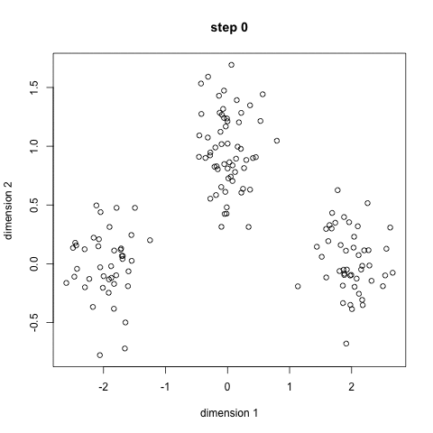

Slide 17
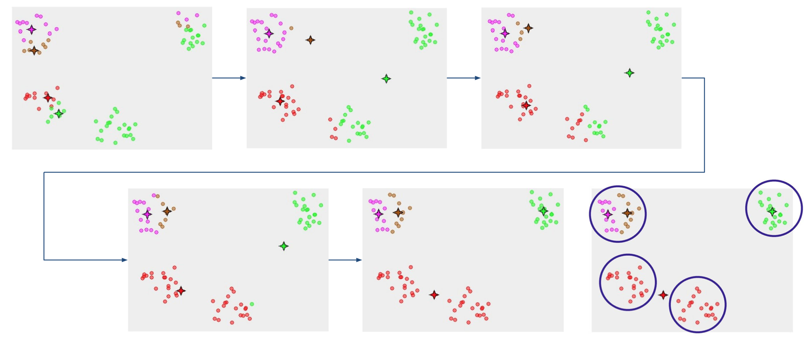
k-Means usually runs with multiple starts

Slide 18
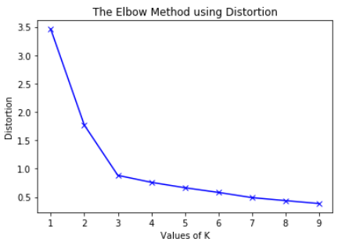
Ideal k can be estimated
As k increases, the “spread” of the data within each cluster will decrease
“Spread”/distortion is sum of squared differences between samples and their cluster centroid
Pick k at the elbow

Slide 19
EM Clustering with GMM
General approach:
Start with a prespecified number of clusters and random parameters for Gaussian/normal distributions
Recursively assign samples to ”most likely” cluster, then recalculate distribution parameters using expectation maximization with assigned samples
Results in a division of the data set into k subsets
Limited to the number of clusters initialized, and samples can be partially assigned to multiple
More flexible cluster shapes than k-Means, and can handle clusters of different densities
Notes:
병찬
GMM - Gausian m modeling

Slide 20
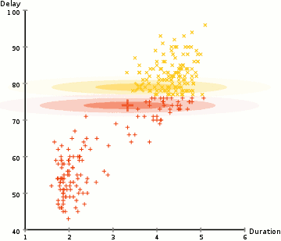

Slide 21
Expectation Maximization
E-step: assign each sample to a cluster
Calculate the probability of each cluster label to each sample using the current Gaussian parameters
M-step: update cluster parameters using samples
Calculate the Gaussian parameters most likely to generate the assigned samples

Slide 22
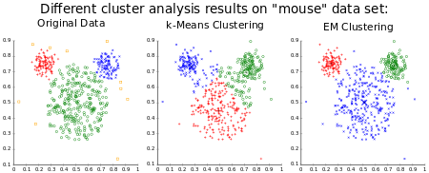
k-Means vs. EM

Slide 23
Mean-Shift Clustering
General approach:
Start with circular windows centered at random
Recursively recalculate mean of samples within circles and shift the window to that center (i.e. denser area)
Repeat until all windows have reached a local optimum of accommodating the most points
Filter for overlapping windows and assign clusters
Results in a division of the data set based on density
Finds its own k value
The selection of window size is a non-trivial problem

Slide 24
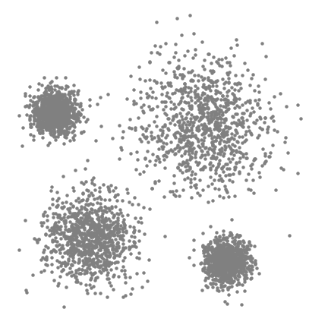

Slide 25
DBSCAN
General approach:
Start with a random unvisited sample and a distance 𝛆
If no neighbors within 𝛆 radius, sample gets labeled “noise”, else recursively assign neighboring samples as part of the same cluster
Repeat until all samples are visited
Results in a division of the data set based on density and identifies outliers as noise
Finds arbitrarily shaped and sized clusters
Not effective when clusters have varying densities

Slide 26


Slide 27
Homework
HW 5 released at 4pm
Programming Assignment 2 due Nov 30
Worth 20% of your grade
Training ANN networks can be very time consuming, please consider getting a start on this soon
Notes:
병찬, 제일 마지막 슬라이드는 여기에 없는데
t-SNE 티즈니 에 관한 것임
https://distill.pub/2016/misread-tsne/

